Slide 1




Moringa School
Syriatel Customer Churn
Presented by Brian Gikonyo

Slide 2
Table of Contents
01
Overview
05
Evaluation
02
Objectives
06
Results and Findings
03
Data understanding
07
Recommendation
04
Modelling

Slide 3
Overview
SyriaTel, a leading telecommunications company, is facing challenges in retaining its customer base.
Customer churn: where customers discontinue their services.
Impacts revenue and company's reputation in a competitive market.

Slide 4
Objectives
Prediction: Develop a robust binary classification model to predict customer churn accurately.
Identify Key Factors: Identify and analyze the key features contributing to customer churn.
Proactive Retention Strategies: Provide actionable insights to the business to implement targeted retention strategies for at-risk customers.
Revenue Protection: Minimize revenue loss by reducing the number of customers who discontinue services.

Slide 5

Data Understanding
Data from Kaggle
3333 Rows and 21 Columns
Data types;
Boolean - 1
Floats - 8
Integers - 8
Objects - 4
Missing Values - None found

Slide 6
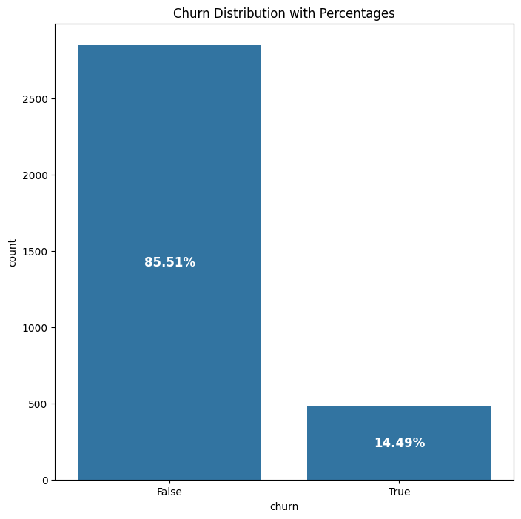
Churn’s Distribution
Dataset is imbalanced

Slide 7
Modelling
Models used are
Logistic Regression - baseline model.
K-Nearest Neighbors.
Hyperparameter Tuning - GridSearchCV and Decision Trees

Slide 8
Modelling
01
02
03
Logistic Regression: baseline model
K-Nearest Neighbors
Hyperparameter Tuning: GridsearchCV and Decision Trees used.

Slide 9
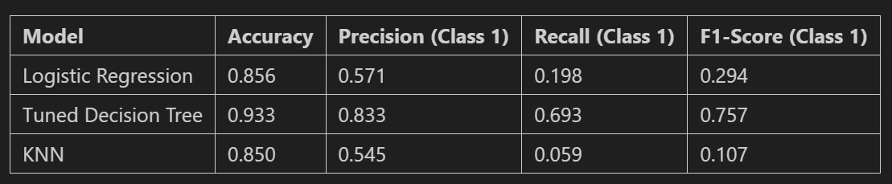
Evaluation
Model Scores
Tuned decision tree model has significantly improved accuracy, precision, recall, and F1-score compared to logistic regression and KNN.
Is recommended for predicting customer churn.

Slide 10
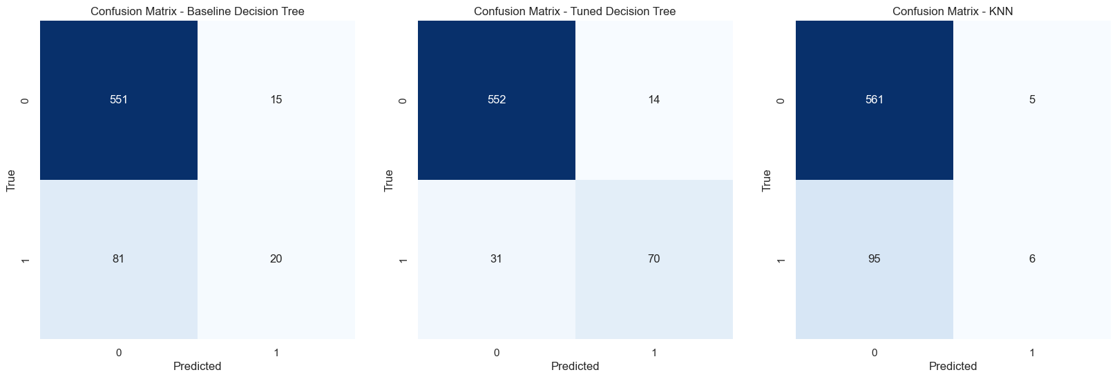
Model Confusion Matrices
Tuned Decision Tree performed best.
Has a better trade-off between true positives and false positives.

Slide 11
Results and Findings
01
02
03
Customer Service Calls (Importance: 23.79%)
Total Day Minutes (Importance: 16.42%)
International Plan (Importance: 11.34%)

Slide 12
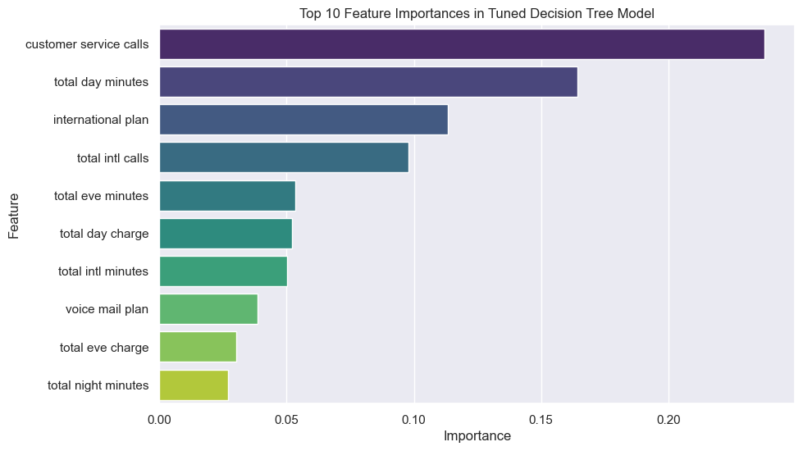

Slide 13
Recommendations
1
2
3
Enhance Customer Service
Personalized Plans and Offers
International Plan Optimization

Slide 14
Thank
You

